Slide 1
caAERS Application Development
AE SIG Meeting
January 11, 2007
Prepared by:
SemanticBits, LLC

Slide 2
Project Status (as of 1/11/06)
Where we are now
Elaboration Phase
2 Months
2 One-Month Iterations
Construction Phase
7 Months
7 One-Month Iterations
Transition
2 weeks
What we implemented in Iteration 1
Login
Create Study for AE Data Entry
Create and Link Participant to Study
Link Existing Study Participant to an Existing Study
Create AE
UI and Application Page Flow Designing
CTMS Interoperabiltity related work
Iteration 1 Artifacts Available
Use Case Document (for Iteration 1 UCs)
SRS
Design Docs
Domain Model
Working code for Iteration 1 Use Cases.

Slide 3
Where to Find Iteration 1 Artifacts
Artifacts in SVN. Go to SCM Tab on GForge
(http://gforge.nci.nih.gov/scm/?group_id=249 )
  Use Case Document (Folder: Use Cases)
  SRS (Folder: SRS)
  Domain Model (Folder: Models)
  Design Documents (Folder: DesignDocs)
  Code (Folder: Deliverables)
  Test Report (Folder: Testing)

Slide 4
F2F Meeting Summary
Vision and Scope
  AE vs SAE:
    Two equally valid points of view.
    Action Plan: Development team working on meeting needs of both views with technology and design (i.e., workflow, skip patterns, batch entry of AEs)
    But still pending.
  Multi-site Settings:
    All instances of caAERS to be local.
    caAERS to support exchange of data among caAERS instances
  Meeting Notes Available on GForge (Folder: Meeting Minutes) http://gforge.nci.nih.gov/plugins/scmsvn/viewcvs.php/docs/Management/Meeting%20Minutes/caAERS%20Elaboration%20F2F%20Meeting%20Minutes.doc?root=caaersappdev&view=log

Slide 5
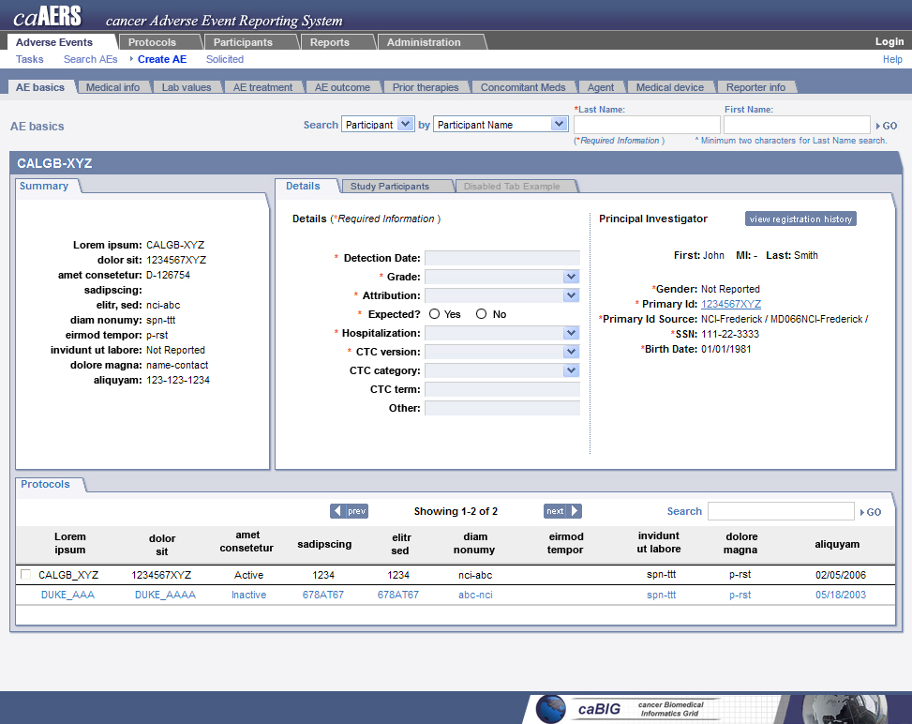

Slide 6
Architecture Overview
Presented by Vinay Kumar

Slide 7
Next AE SIG Meeting
Prototype of Iteration 1 and 2 Use Cases, to include initial page design and workflow.
Questions that arise regarding Iteration 2 Use Cases and items needing elaboration per the F2F discussions.

Slide 8

Single Sign On
Other CTMS
Web Application
ESB
Rules Engine
caAERS CORE
FDA
SPONSOR
DB
PI
Notification Service
Inbound binding components
outbound binding components

Slide 9
Any other system
ESB
u/p
u/p
WS
WS
u/p
Grid proxy
WS
WS
Grid proxy
Grid proxy
GS
GS
Grid proxy

Slide 10
Questions?

